Slide 1
ADS-B-Ground-Station
Student name: adelle mcateer

Slide 2
Additional Resources & Features
Content
Flight Aware
My Flight Aware & My ADS-B
Virtual Radar Desktop
Mobile Apps
ThingView
RaspController
Additional information
Aviation codes
PiAware project examples

Slide 3
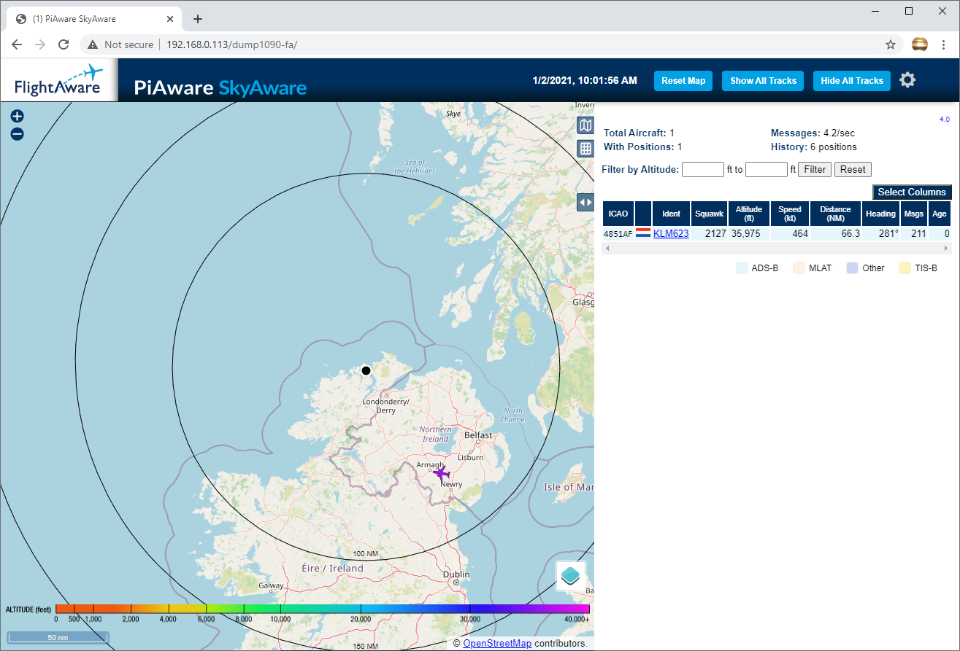
SkyAware API
This is how it looks in the browser.
To view flight information, click on the flight number to open a new window.

Slide 4
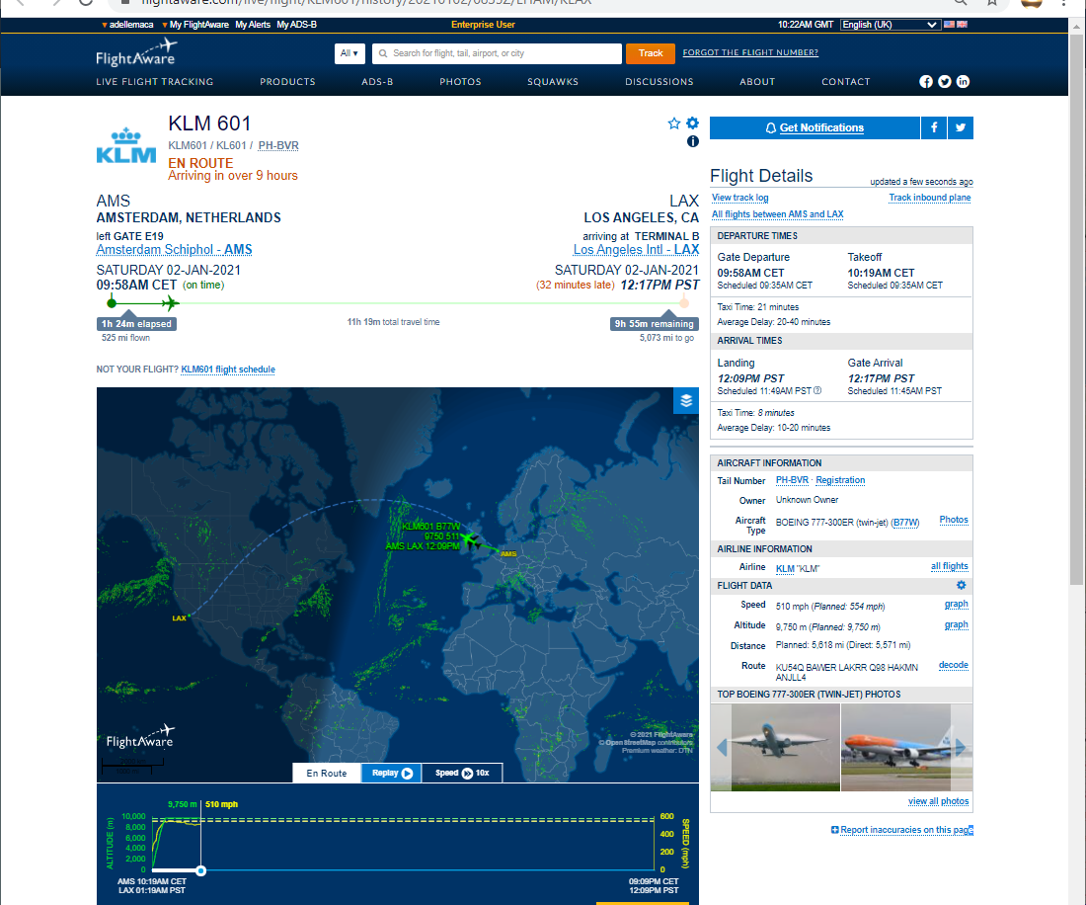
Flight Details
A view of live information available.

Slide 5
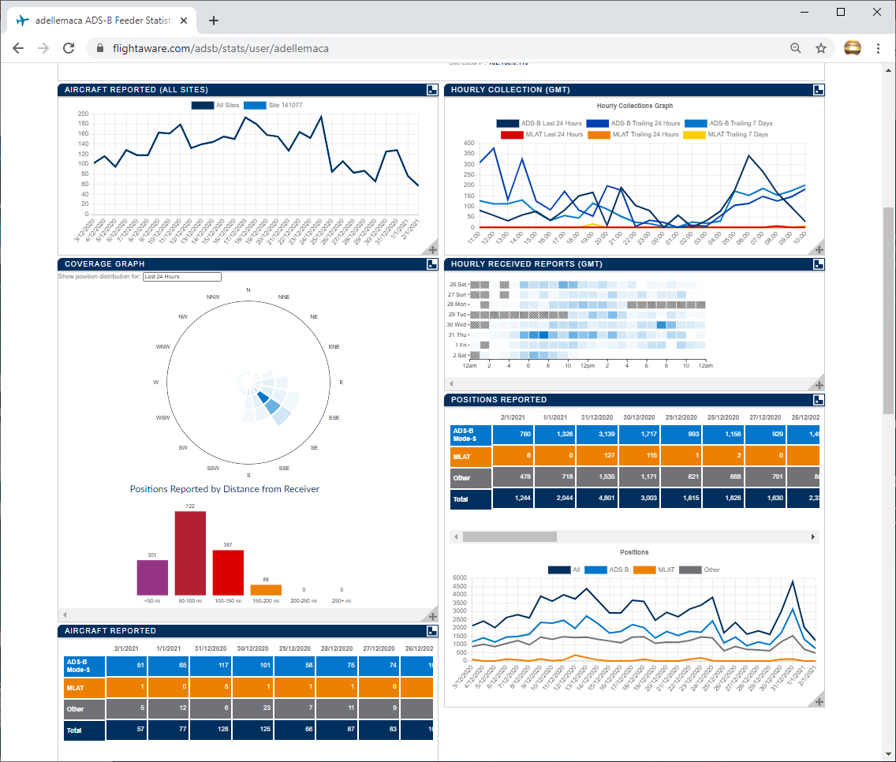
My Flight Aware & My ADS-B
In return for sending data to Flight Aware you receive a free enterprise level account.
You also have access to a wealth of data and statistics.
Allows configuration of your location and nearest airport.
Setup information here: https://flightaware.com/adsb/piaware/install

Slide 6
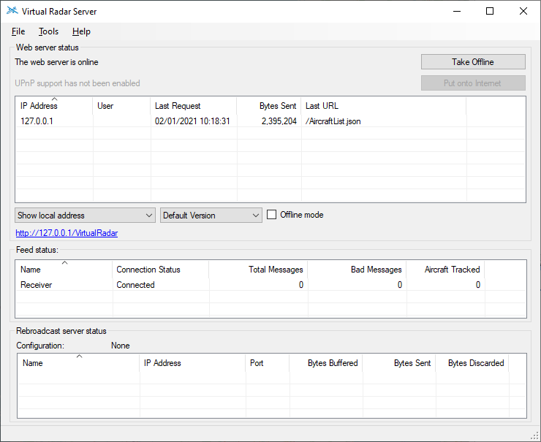
Virtual Radar Server
Virtual Radar Server is an open-source .NET application that runs a local web server.
A different way to represent the data using the PiAware web portal IP address.

Slide 7
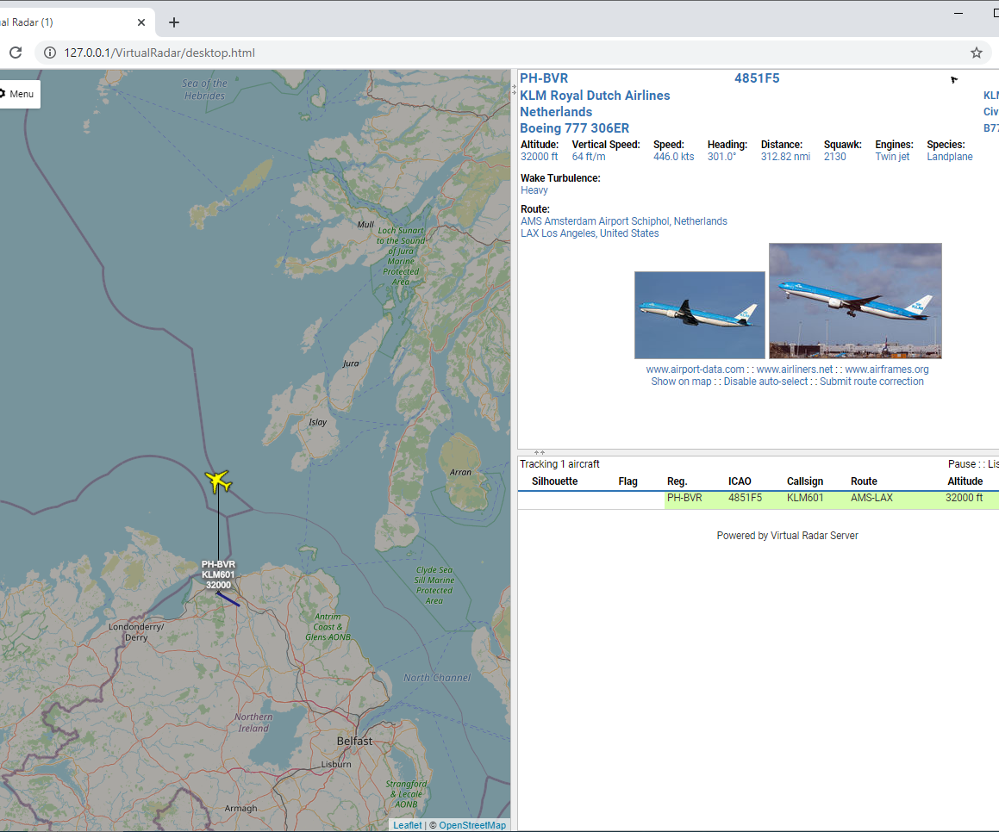
Virtual Radar Server
How it looks in the browser.
More condensed view than SkyAware.
Information available on one window.

Slide 8
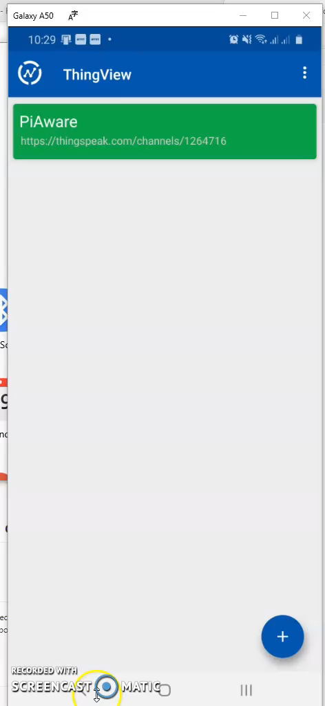
ThingView Mobile App
I just discovered this so it is not included in my submission.
It allows you to view your ThingSpeak channels on the ThingView mobile app.
Useful for viewing the status of the RaspberryPi along with the weather information.

Slide 9
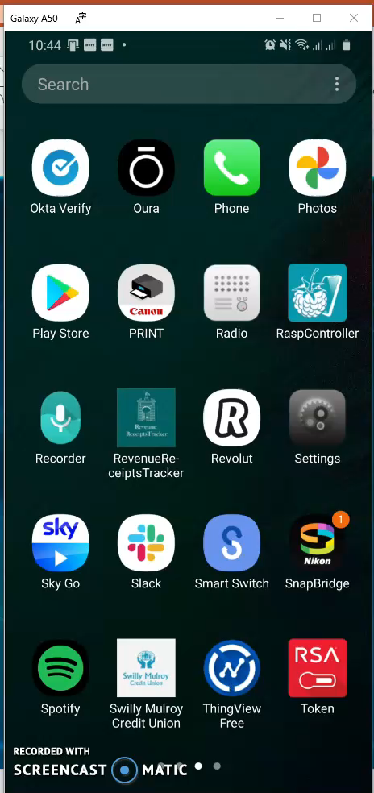
RaspController Mobile App
I recently started to explore the functions of this app.
Allows ssh access to the RaspberryPi on my mobile phone.

Slide 10
Additional information
What is a HEX code?
All modern aircraft are assigned a unique ICAO 24-bit address (also known as Mode-S 'hex code') since 2007 based on registration allocated by the relevant civil aviation authority.
Normally the address is never changed; however the onboard transponders can be wrongly programmed. They can also be swapped between aircraft with the maintenance team forgetting to reprogram the transponders.
There are 16,777,214 unique addresses available (2^24-2). Each address can be displayed in any of 3 formats: hexadecimal, octal or binary.
Source: http://www.aerotransport.org/php/go.php?action=definition_hex

Slide 11
Additional information
What is a Squawk code?
A squawk code is a four-digit code given by ATC to all aircraft in the airspace for communication purposes.
The primary goal of a squawk code is to provide effective communication between the ATC and the aircraft.
Squawk codes are four digits, with each being a number between zero and seven. This gives thousands of possible combinations for air traffic control to give to aircraft.
There are a few reserved squawk codes.
Source: https://simpleflying.com/squawk-codes/

Slide 12
Aviation Articles I found interesting
https://911researcharchives.org/september-11-2001-timeline/'hjk'-text-message-sent-to-korean-air's-base-from-unknown-source/
https://theaviationist.com/2020/09/29/yes-u-s-rc-135s-have-used-bogus-hex-codes-to-transmit-a-false-identity-but-its-not-to-fool-china-or-other-enemies/
https://blog.flightaware.com/aviation-stats-update-12-29-2020

Slide 13
Some PiAware projects I found online
https://www.stuffaboutcode.com/2015/10/piaware-aircraft-overhead-led.html
https://www.instructables.com/PiAware-Radar-Kiosk/
Mobile Flightaware setup | Hackaday.io

Slide 14
This is just some additional information that I wanted to share.
I plan to continue developing this in my spare time.
I would like to have more access to the flight information and receive more detailed notifications.

Slide 15
Thanks for your time.
Happy New Year!

